Slide 1
Website Optimization using SDL SmartTarget
John Winter
Partner, SDL MVP, Content Bloom

Slide 2
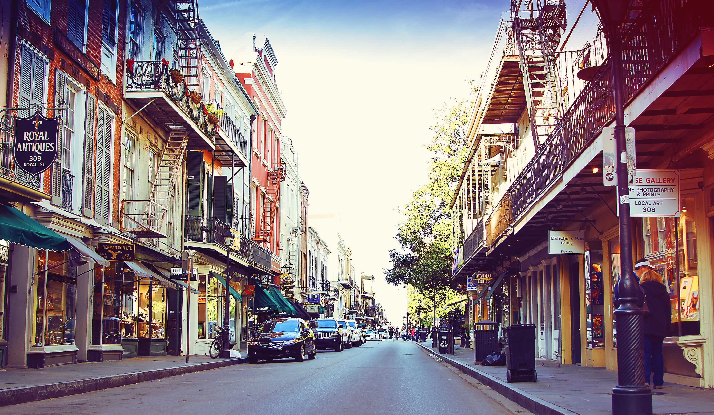

John Winter
Consultant and partner
at Content Bloom
@wntr & @contentbloom
tweet me your feedback

Slide 3
Agenda
The process of optimizing a simple homepage for personas using SmartTarget
An overview of the installation of SmartTarget
How to use custom data in SmartTarget
Anything you’d like to know along the way

Slide 4
What is SmartTarget?
Targeted Content
Experiments
Promotions
Dynamic Navigation
Notes:
Basically this is all the same, we started the project as TRI or STRI (released version 1 September 2014), which stands for the SDL Tridion Reference Implementation, and we are currently working on what we call the Digital Experience Accelerator (abbreviated as DXA), which is version 1.1 (or 2.0, however you want to see it) of STRI.
The name is not so important, as long as you understand what it is. Call it a reference implementation, or an implementation accelerator. What you get is an example implementation in a box, that you can extend with modules. Ideally this means that you wouldn't have to do any coding to deliver an implementation.
Reality tells us that needs a lot more modules than currently are available, but let that not stop us here!
Let's name it DXA from now on (and I might still accidentally call it TRI ;o).

Slide 5



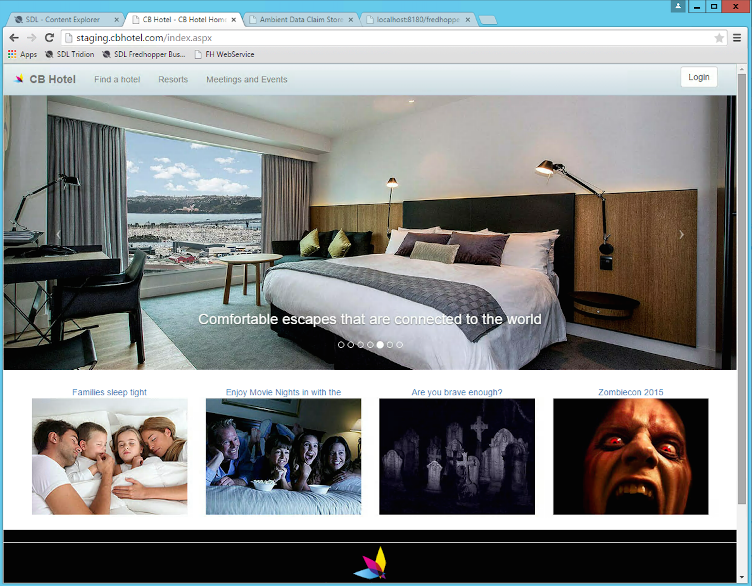


How SmartTarget works
It’s actually quite simple…
Gather information:
Visitors, Locations, Device, Weather, Date etc.
SmartTarget crunches this data
Returns the content that is targeted
Notes:
[This needs some images to back the story, and way less text on the slide]
We want to keep you away from changing the core, since we tend to lock that down so it is supported.
We will need some time to lock it down properly, so we don't make the wrong decisions here and limit your possibilities.

Slide 6
Our test subject – A hotel website
Hotels offer more than just beds:
  Conferences & Events
  Weddings & Parties
  Business meetings
  Spa & Relaxation

Slide 7

Different types of customers
Coffee &
Conference Rooms
Someone to keep the kids busy
Drink a lot of alcohol and raise the roof
Good Wifi!!!

Slide 8
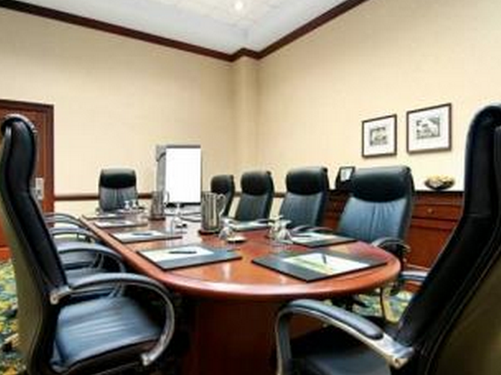


Targeting these customers
Search Term | Location | Existing customer? | Result
Meeting Rooms | New Orleans | Yes
Child friendly swimming pool | Halifax | No
Zombie Conference | Austin | Yes
Drink a lot of alcohol and raise the roof
Party!!

Slide 9
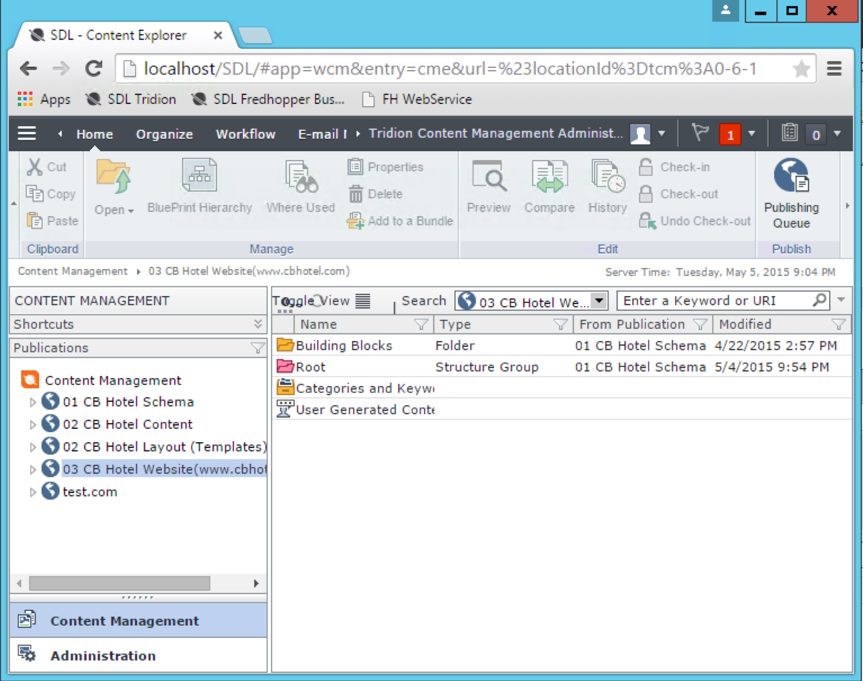



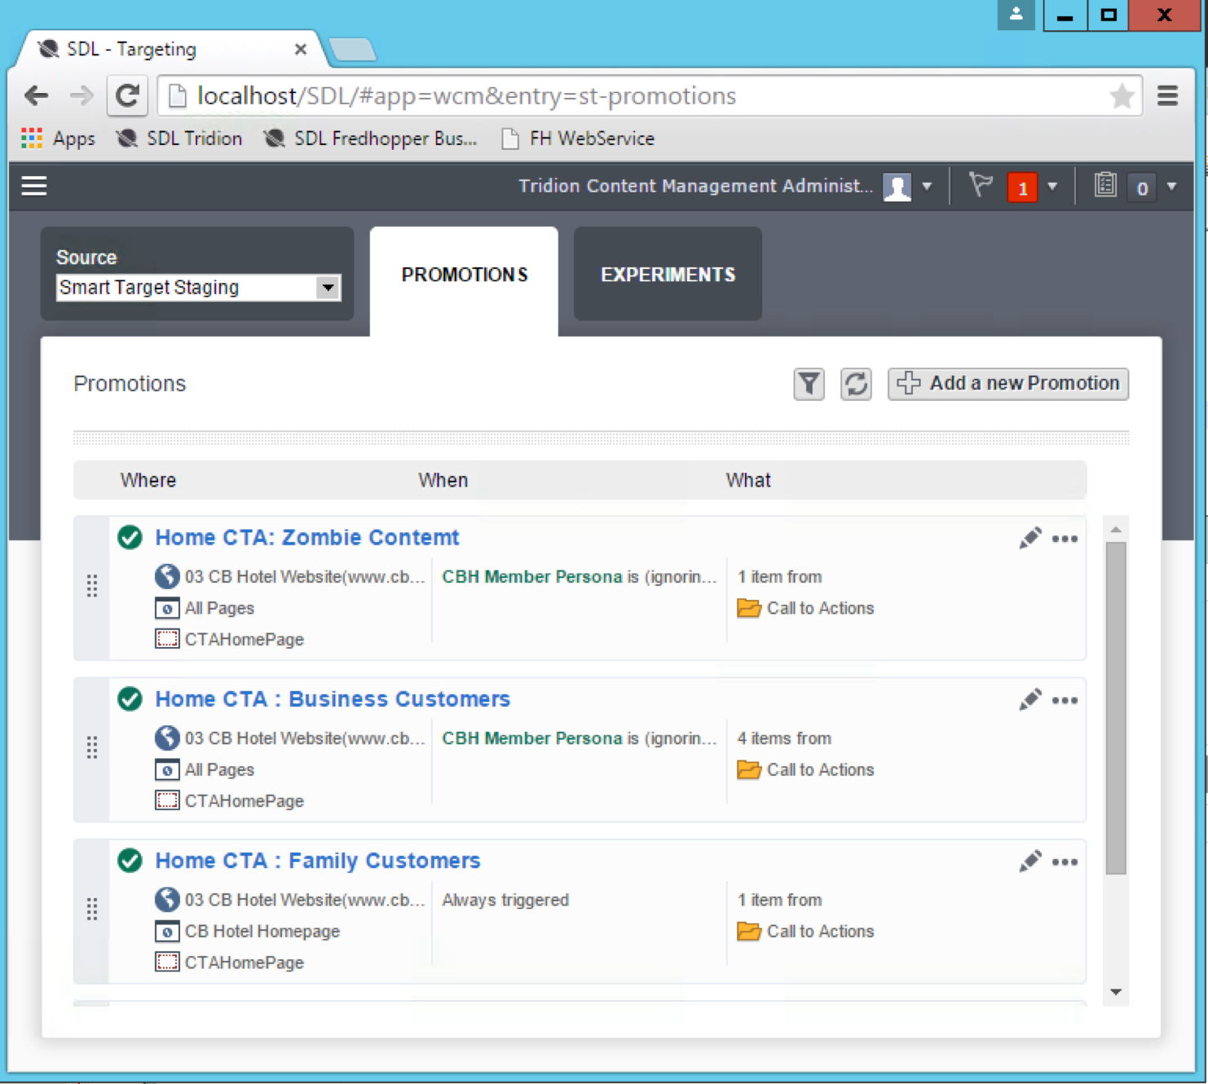

The bigger picture
Content / Marketing Team(s)
SDL Tridion / SmartTarget
SDL Fredhopper
SDL Content Delivery
Happy End Users
Notes:
[This needs some images to back the story, and way less text on the slide]
We want to keep you away from changing the core, since we tend to lock that down so it is supported.
We will need some time to lock it down properly, so we don't make the wrong decisions here and limit your possibilities.

Slide 10
Demo

Slide 11
The installation
Notes:
Public API

Slide 12
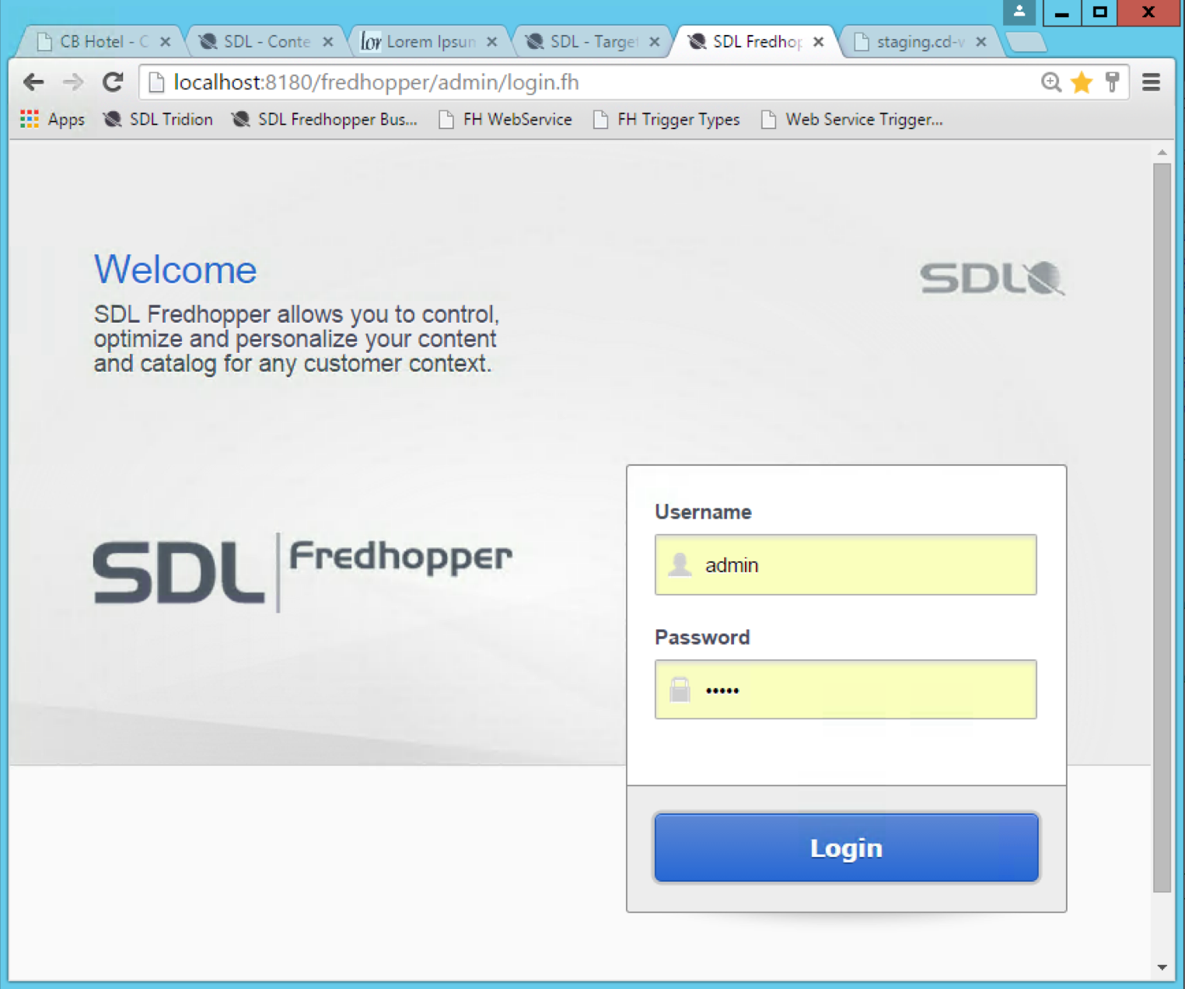
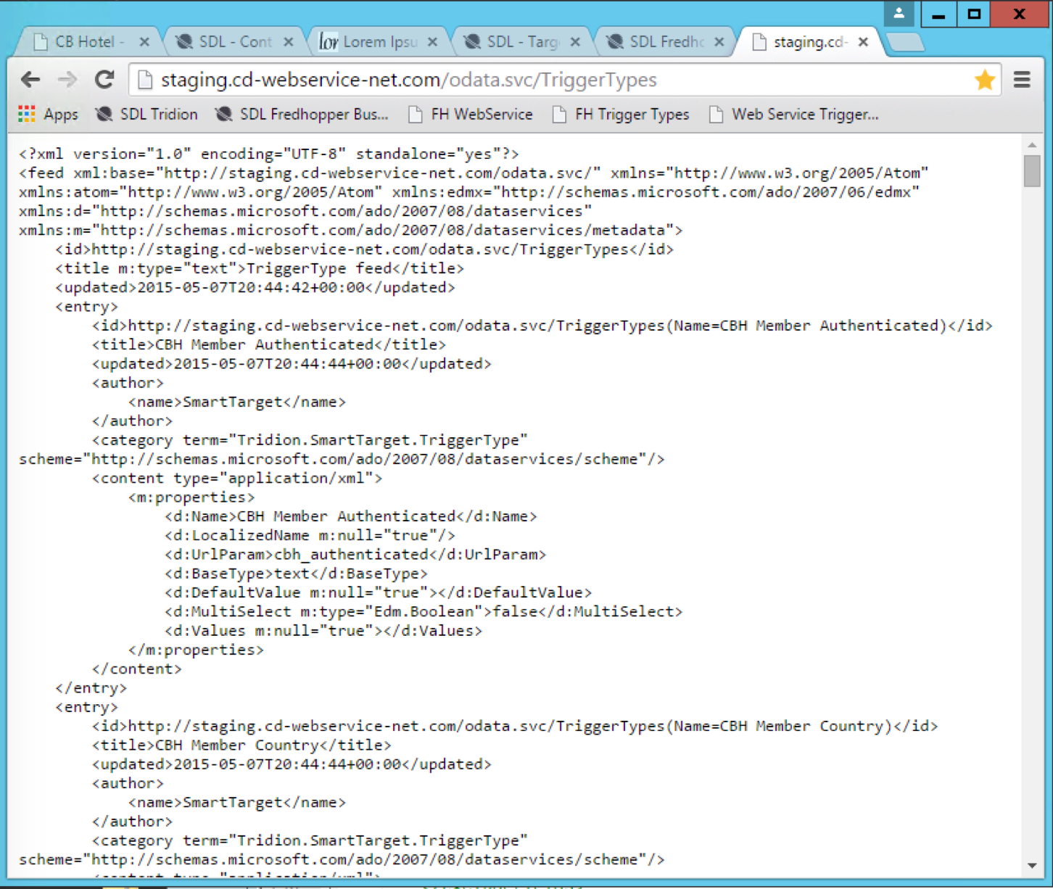


A few moving pieces
WS
ADF
Installation of SmartTarget extension & building blocks
Configure Publishing Targets
Configure Deployer to send published content to Fredhopper
Installation of SDL Fredhopper
Set up indexer and instance(s)
Configure Trigger Types
Content Delivery
Web service
Website / App
Ambient Data Framework (ADF)

Slide 13
Smarttarget_conf.xml
Handles the configuration (for the most part)
  The location of Fredhopper
  Claims
  Catalogs (The content in Fredhopper)
  The Content Regions
Once it’s all good, you can copy where needed
Notes:
[Needs better presentation, this is unreadable]

Slide 14
Implementing SmartTarget

Slide 15
Implementing SmartTarget
The implementation is in two parts:
  Setting up your templates in Tridion
  Creating and adding your own data (optional)
Notes:
[Needs better presentation, this is unreadable]

Slide 16
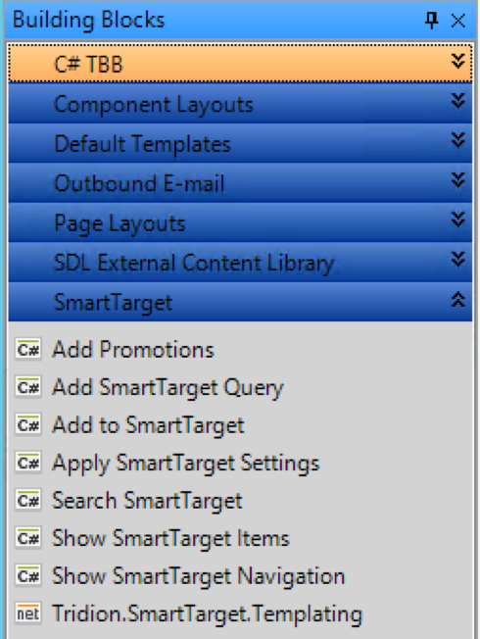
Content Manager Templating
As part of the install process you end up with a load of SmartTarget building blocks
There’s also some simple syntax for your pages templates
Notes:
[Needs better presentation, this is unreadable]

Slide 17
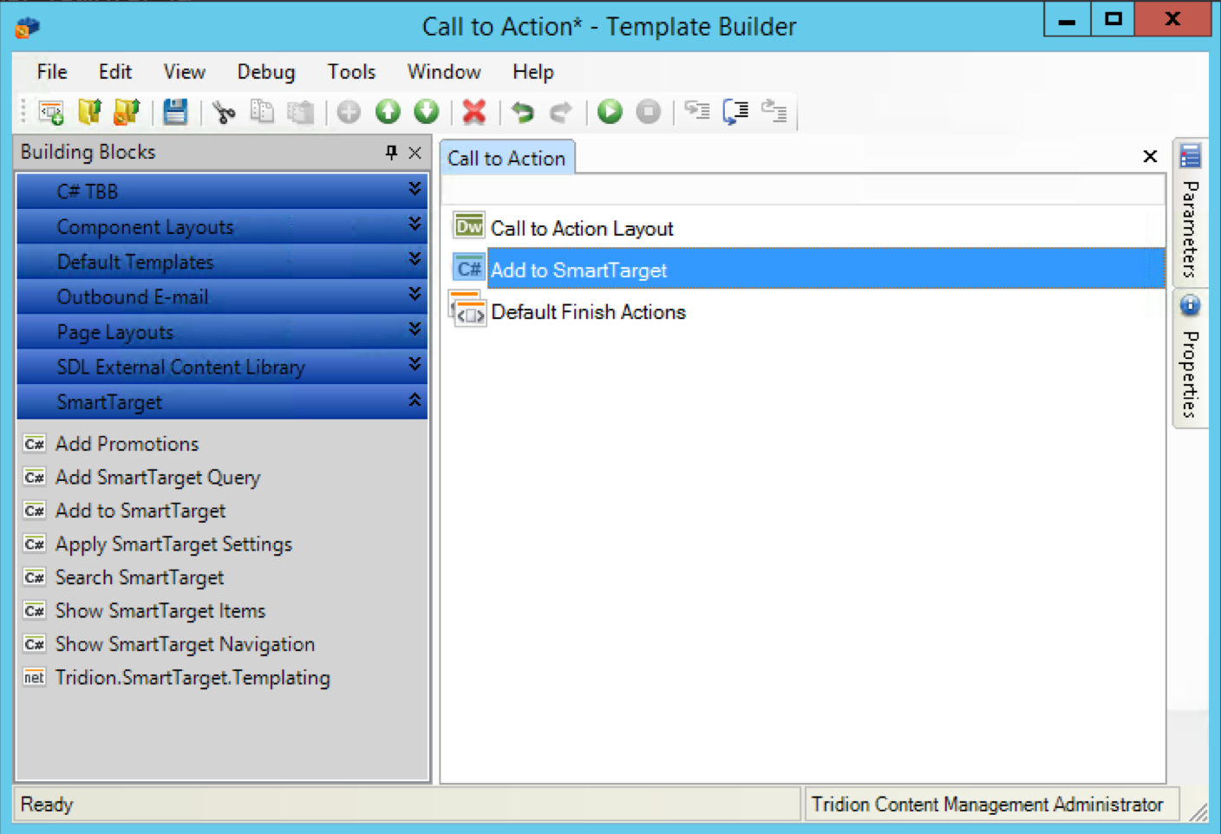
Component Templates
Drop in Add to SmartTarget
Notes:
[Needs better presentation, this is unreadable]

Slide 18
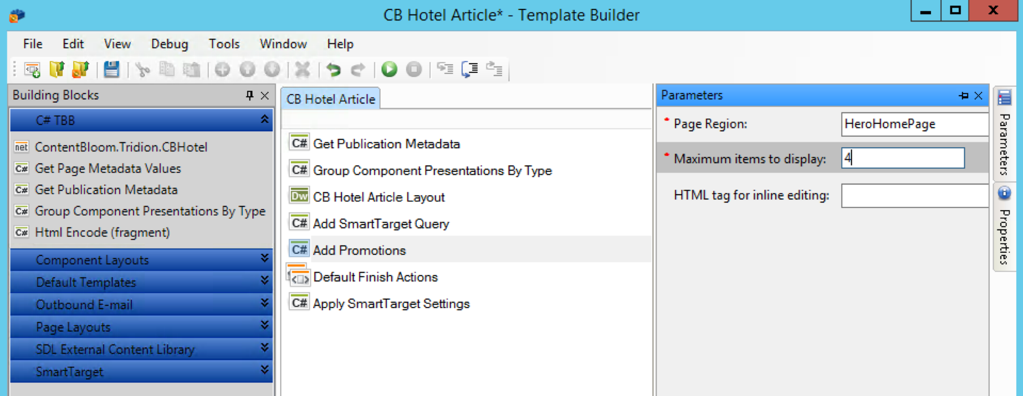
Page Templates
Notes:
[Needs better presentation, this is unreadable]
http://www.tridiondeveloper.com/tridion-reference-implementation-patterns-2-mixing-cms-content-with-external-data

Slide 19
Page Layout
Add the <tcdl:region> syntax to your page DWT:
  <div class="col-xs-3" >
  <ul>
  <tcdl:region id=”HeroHomePage" type="SmartTarget">
  <!-- TemplateBeginRepeat name="CalltoActionComponents" -->
  @@RenderComponentPresentation()@@
  <!-- TemplateEndRepeat -->
  </tcdl:region>
  </ul>
  </div>
Notes:
[Needs better presentation, this is unreadable]

Slide 20
Published Output
  <smarttarget:Promotions MaxItems="4" Region="HeroHomePage" runat="server">
  <ItemTemplate>
  <smarttarget:PromotionalItems runat="server”
  <ItemTemplate>
  <tridion:ComponentPresentation runat="server" PageURI="tcm:6-1259-64" ComponentURI="<%# Eval(&quot;ComponentUri&quot;) %>" TemplateURI="<%# Eval(&quot;TemplateUri&quot;) %>"/>
  </ItemTemplate>
  </smarttarget:PromotionalItems
  </ItemTemplate>
  <FallbackContent>
  <tridion:ComponentPresentation runat="server" PageURI="tcm:6-1259-64" ComponentURI="tcm:6-1296" TemplateURI="tcm:6-1250-32"/>
  </FallbackContent>
  </smarttarget:Promotions>
Notes:
[Needs better presentation, this is unreadable]

Slide 21
Using custom data

Slide 22
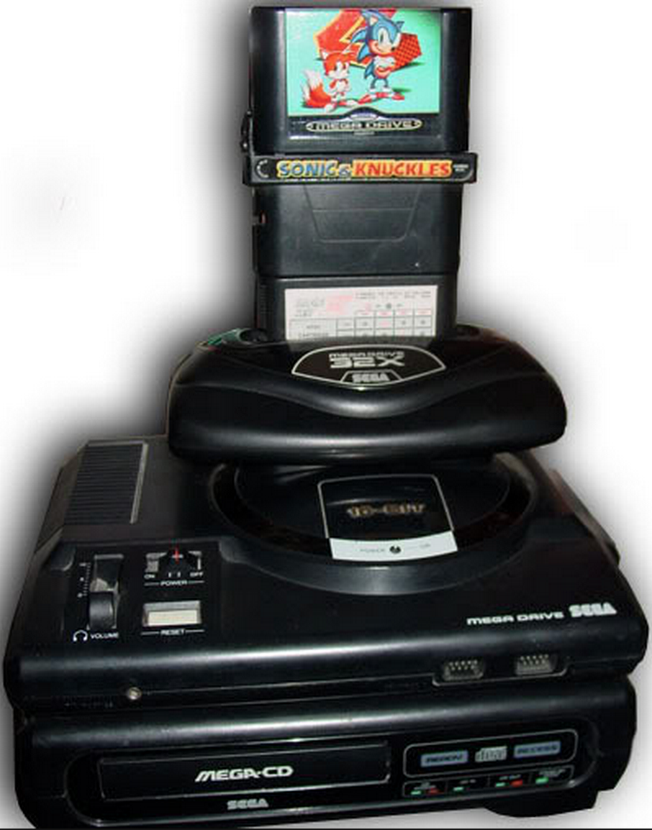
Gathering Information
To gather information, we create an Ambient Data Framework (ADF) Cartridge.
The ADF is a Tridion Content Delivery Module that is used to glue together different Tridion Modules
Notes:
Probably better to demo this and explain while showing instead of a slide with too much text

Slide 23


Configuration
smarttarget_conf.xml
cd_ambient_conf.xml
trigger-types.xml
custom_cartridge_conf.xml
custom_cartridge.jar

Slide 24
Demo: ADF

Slide 25
Tips

Slide 26
Tips & Tricks
Keep some code handy to inspect the contents of the ADF
Logging shows the query sent to SmartTarget
Remember your claim prefix:
  <taf_claim_cbhotel>cb_</taf_claim_cbhotel>
Ensure that the fredhopper service is running
Content not in SmartTarget?
  ‘Add to SmartTarget’ building block
Notes:
Probably better to demo this and explain while showing instead of a slide with too much text

Slide 27
Let’s get drunk !

